Slide 1
📍
MapFolio
Organize your favorite places on a personal map
Demo Day • Built solo over 3 weeks • No backend, no account, your data stays on your device

Slide 2
What is MapFolio?
🔒
No account needed
MapFolio is a free web app for organizing your favorite places on a personal map.
Import your existing Google Maps saved places, or start fresh and build your own collections from scratch.
Sort everything into folders, tag places with custom categories, and color-code them by status: Want to Go, Loved It, Skip It.
There's even a trip planner that turns any collection into a day-by-day itinerary.
Your data stays on your device
🆓
Free to use
Nothing to buy, nothing to sign up for
🗺️
Works with Google Maps exports
Bring in your existing saved places

Slide 3
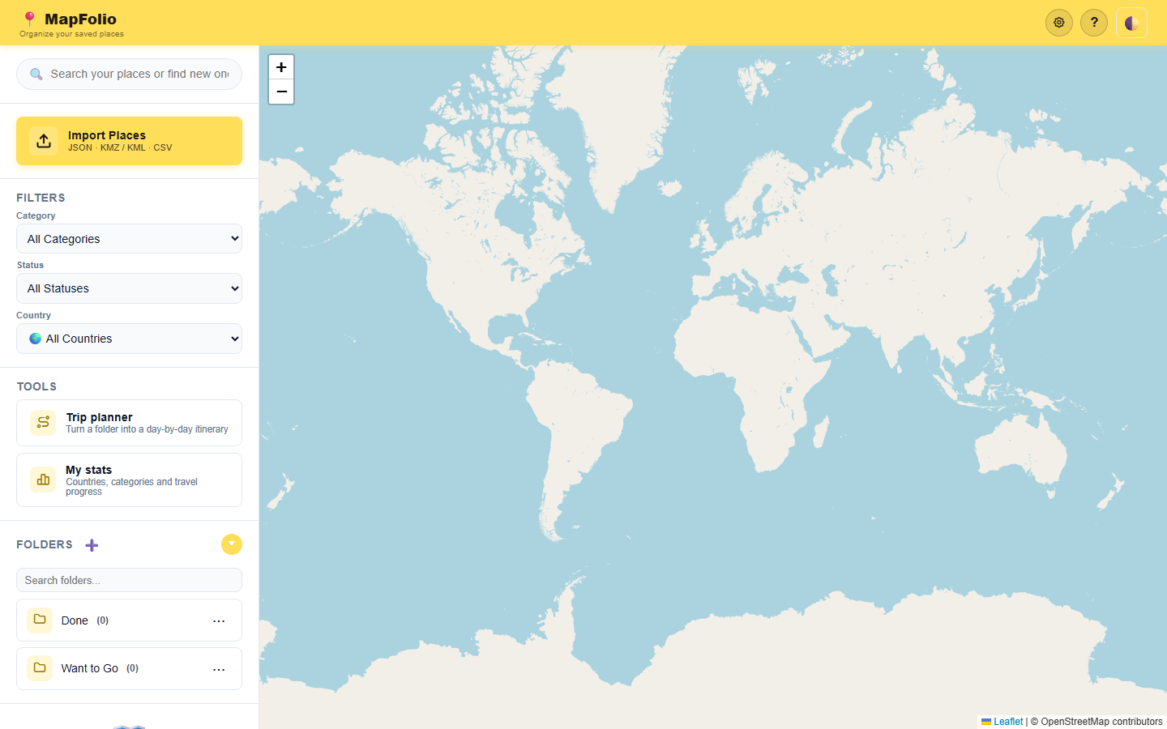
What I set out to explore
Google Maps lets you star and save places — but never lets you organize, search, color-code, or plan trips around them.
Goal: build a tool that takes that pile of saved places and turns it into something useful — sortable, searchable, shareable, and tied to an actual trip plan.
Constraint I set for myself: no backend, no account system, no framework — just HTML, CSS and JavaScript, so anyone can open it and their data never leaves their device.
Built with: vanilla JS, Leaflet maps, OpenStreetMap data

Slide 4
What I achieved
📥
🗂️
🎨
Import from anywhere
Folders & custom categories
Status color-coding
Google Takeout JSON, KML/KMZ, CSV — with auto-geocoding for places missing coordinates
Auto-detected categories, bulk editing, your own emoji tags
Want to Go, Been There, Loved It, Skip It, Favourite — at a glance on the map
🧭
📱
💾
Trip planner
Mobile-first redesign
Backup, restore & sharing
Turn any folder into a day-by-day walking or driving itinerary
Bottom sheets, accordions, dark/light themes, installable as a home-screen app
Export your whole collection or a single folder as a file — no account needed

Slide 5
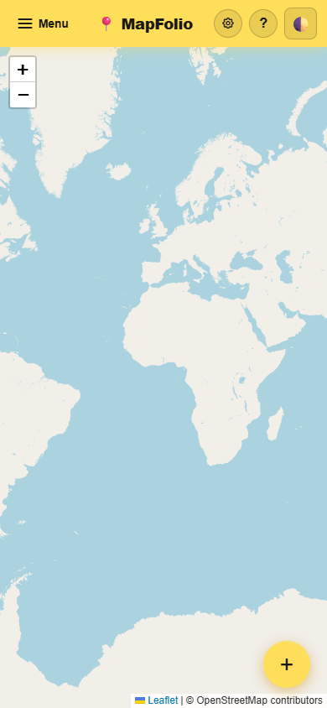
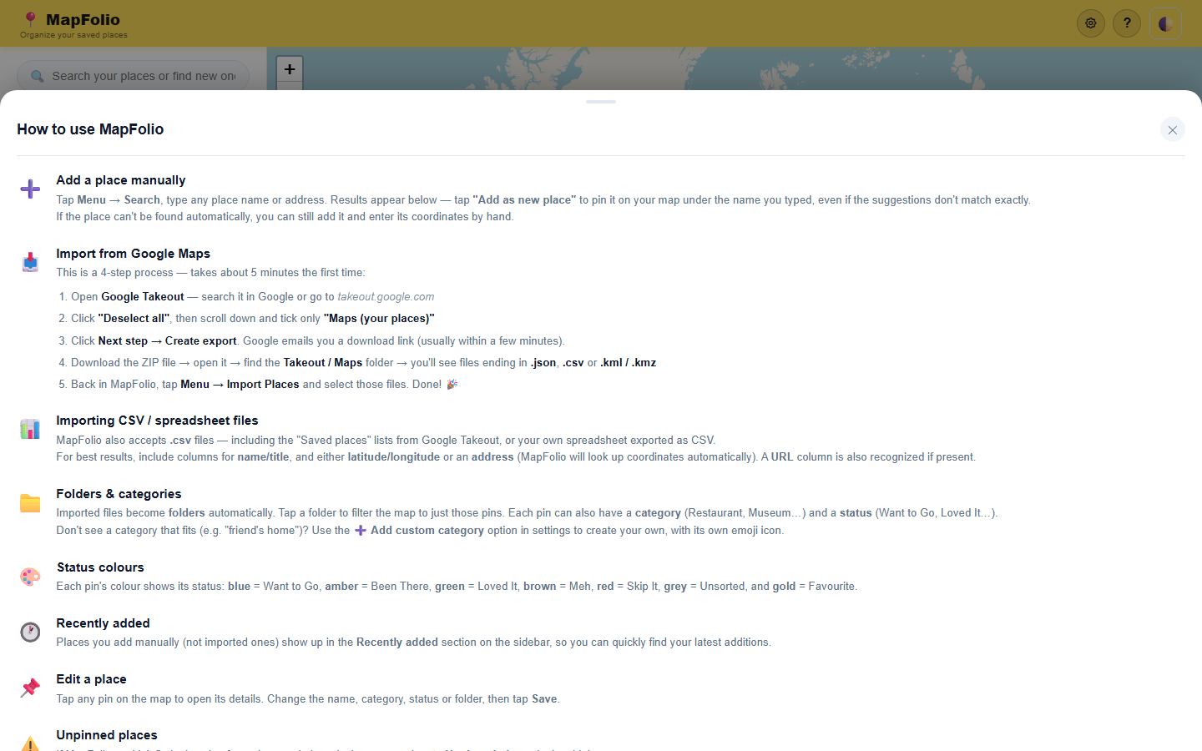
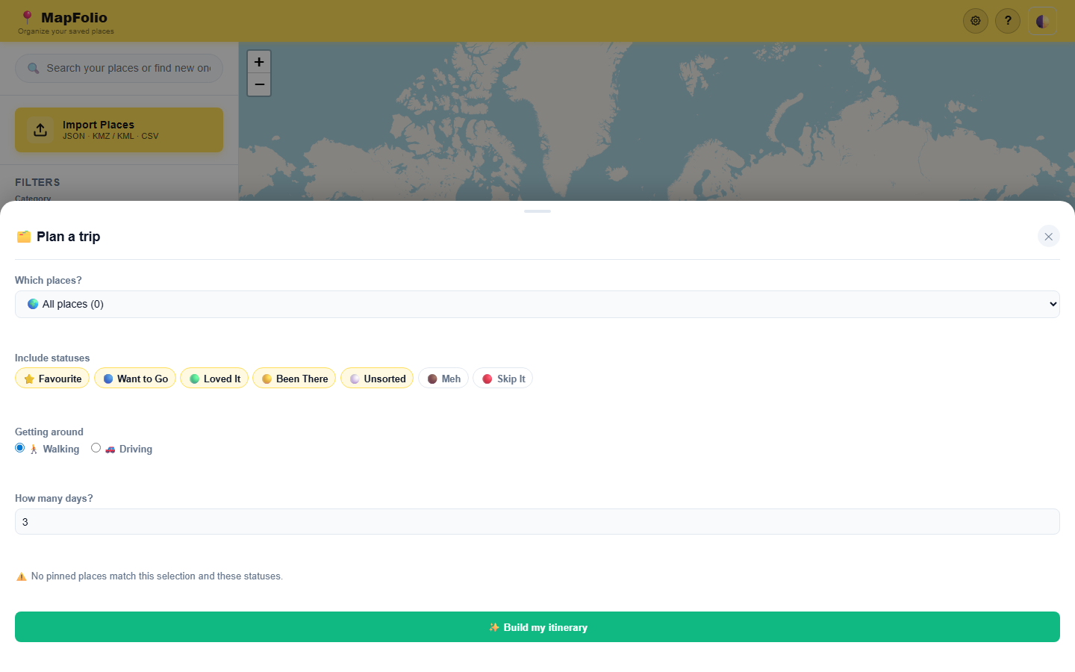
A quick look
Built-in step-by-step help guide
Trip planner: pick a folder, statuses & days → get a route
Mobile-first layout, installable to your home screen

Slide 6
What surprised me
🌀
Google's own export formats are a mess
Saved places come out differently depending on whether you use Takeout JSON, CSV, or KML — I ended up supporting all of them.
🧩
"Small" UI fixes are never small
A folder menu took 5 separate commits to get right across mobile and desktop — clipping, z-index, overlap, one after another.
⚡
How far plain HTML/CSS/JS gets you
No framework, no build step — just a couple of CDN libraries (Leaflet, JSZip) — and it still feels like a real app.

Slide 7
Challenges along the way
UI / UX
Data & architecture
Geocoding places that have no coordinates in the import file
Mobile layout edge cases — accordions, clipped menus, z-index fights with map controls
Designing a categorization system flexible enough for anyone's “saved places” chaos
Cross-device sync without a server — solved with export/import + merge
Handling 4+ different import formats reliably (JSON, CSV, KML/KMZ)
Keeping a single 5,700-line app maintainable while iterating fast

Slide 8
Key lessons & insights
Real data finds real bugs
Data ownership matters
Testing with my own (messy) saved places surfaced UI issues a clean test dataset never would have.
For a personal-data tool, investing early in import/export and “no account needed” paid off — it's also the easiest trust story to tell.
Mobile constraints improve design
Done is a moving target — and that's OK
Solving for small screens first led to a cleaner UI overall, not just a compromise.
There's always one more format, one more edge case. Shipping something useful beats shipping something complete.

Slide 9
Questions people ask me
“What's the value beyond just tracking been-to / want-to-go?”
Your own categories + color-coded statuses across all saved places, a trip planner that builds itineraries from a folder, and full ownership/portability of your data — none of which Google Maps offers.
“Can I import these places back into Google Maps?”
Not yet — exports are MapFolio's own format today, for backup and sharing between MapFolio users. Two-way sync with Google Maps (KML export) is on the wish list.
“Is this connected to Booking.com?”
Not today — right now it's purely a personal map and trip-planning tool, no external services. But it's a natural future direction: affiliate links to Booking.com, TripAdvisor, etc. for the places in your collection.
“What if a shared folder has a place I've already visited?”
Your existing status always wins — if MapFolio recognizes the place (same link or name), the imported copy is skipped so your status (e.g. "Loved It") isn't overwritten. It just won't show up in the new shared folder.

Slide 10
What's next: an idea worth exploring
💡 Sell curated trip collections
A folder of places + a trip-planner itinerary is basically a ready-made travel guide. People already pay for “where to eat in Lisbon” PDFs and curated maps — MapFolio could let creators package and sell their own collections.
🗂️
🧭
🔁
Premium folders
Itinerary included
Built on what exists
Creators (locals, frequent travellers, influencers) publish a folder as a paid “trip pack” — e.g. “3 days in Lisbon, foodie edition”.
Buyers get the places plus a ready-made day-by-day plan from the trip planner — not just a list of pins.
The export/import and trip-planner features already do most of the work — this is mainly a packaging + marketplace layer on top.
Still an open question: how to keep “no account needed” for browsing while supporting payments and creator profiles for sellers.

Slide 11

Try it yourself
🔗 Open the link on your phone or laptop — no install, no sign-up
📲 Add it to your home screen for one-tap access
📥 Try importing a few Google Maps saved places, or just add some manually
🔒 Everything stays on your device — nothing is uploaded anywhere
Scan to open MapFolio
my-mapfolio.netlify.app
Thank you! Feedback, bug reports, and “what about X” ideas all very welcome.

